Slide 1

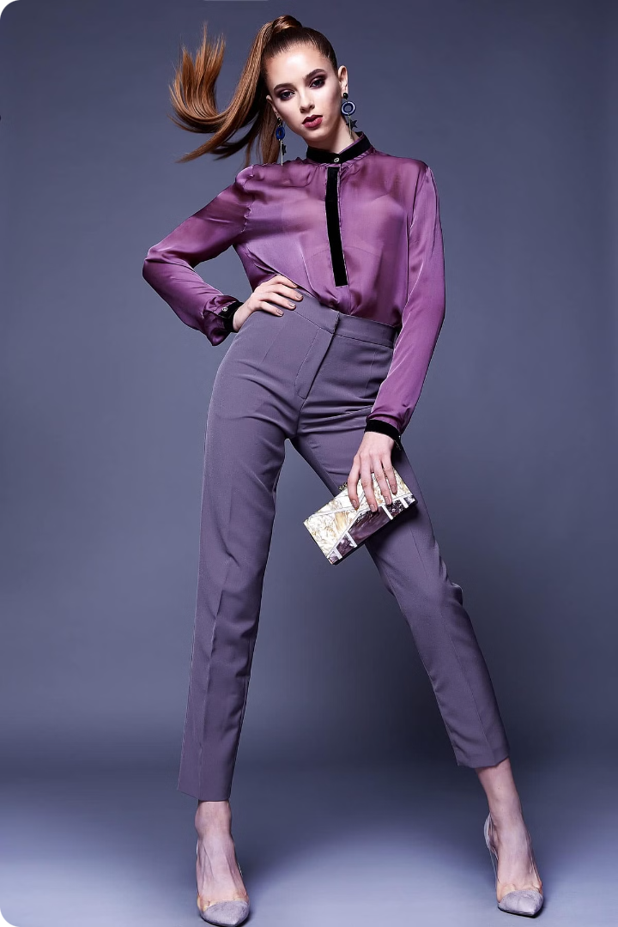


Redefining Fashion Engagement: Myntra GenZ
Myntra GenZ, a fashion-forward platform, seeks to enhance its social shopping experience, fostering deeper engagement among young Indian audiences.
by Jhanvi Jain

Slide 2
The Problem: Lack of Meaningful Engagement
1
Passive Consumption
2
Limited Interaction
Today's youth are bombarded with information, leading to low retention and engagement on shopping platforms.
Traditional e-commerce platforms often lack interactive features, resulting in a disconnect between brands and consumers.
3
Lack of Social Proof
4
Short Attention Spans
Younger audiences rely heavily on social recommendations, but current platforms fail to provide a robust social experience.
In the age of fast-paced digital content, traditional shopping experiences struggle to capture and hold users' attention.

Slide 3
The Impact: Missed Opportunities
Decreased Conversion Rates
Limited Brand Advocacy
Loss of Market Share
Without engaging experiences, users are less likely to recommend the platform to their peers.
Competitors are actively innovating, capturing the attention of GenZ and leaving Myntra behind.
Low engagement translates to lower conversion rates, impacting sales and revenue growth.

Slide 4
The Solution: Social Shopping Integration
Live Shopping Experiences
Virtual Wardrobe
Leveraging live video for fashion shows, product launches, and interactive sessions with influencers to create a real-time shopping experience.
Integrating a virtual wardrobe to allow users to share their outfits, receive feedback, and discover new styling options, fostering a community within the app.
Personalized Content & Recommendations
Gamification and Rewards
Implementing gamified elements like challenges, rewards, and contests to incentivize engagement and encourage repeat visits.
Utilizing user data and AI to deliver personalized recommendations, product suggestions, and curated content based on individual preferences.

Slide 5
Feasibility & Implementation
Technology Integration
Marketing & Promotion
Integrating APIs for live streaming, social media sharing, and AI-powered recommendations.
Launching a comprehensive marketing campaign to promote the new features and highlight the social shopping experience.
1
2
3
4
User Interface & Experience Design
Community Building
Encouraging user participation through contests, influencer collaborations, and creating a dedicated space for user-generated content.
Designing an intuitive and engaging user interface that seamlessly integrates social features into the shopping experience.

Slide 6




Benefits: Enhanced Engagement, Increased Conversion
Increased User Acquisition
Enhanced Customer Loyalty
Increased Conversion Rates
Improved Brand Image
Attracting a larger audience by offering a unique and engaging shopping experience.
Building a stronger connection with users through social interaction and personalized experiences.
Driving sales and revenue growth by encouraging users to make purchases through interactive and engaging content.
Positioning Myntra as the go-to destination for fashion-conscious young adults in India.

